Slide 1
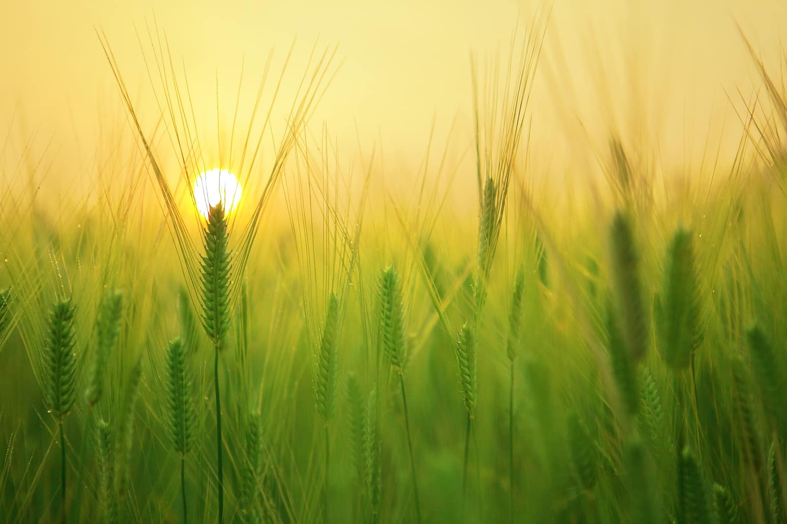
SMART AGRICULTURE + AI
Intelligent Farm
Operations Platform
(Smart Agro Precision System)
A centralized digital platform designed to streamline farm, crop, soil, yield, and expense management while integrating AI capabilities for smarter agricultural decision-making.
Team Members :-
Aditya Raj
Ganesh Raj
Under the Mentorship of :-
Sivadharani K
Pritam Kumar
Suramya Biswas
Madivada Hanu Harshitha
Notes:
1

Slide 2
INTRODUCTION
Intelligent Farm Operations Platform is a centralized digital platform designed to simplify and organize agricultural operations. It brings farm, crop, soil, yield, timeline, and expense management together in one system, while integrating AI capabilities through Hugging Face to support smarter and more efficient agricultural decision-making.
Tagline: “Transforming traditional farm management into a smarter, organized, and technology-driven process.”

Slide 3
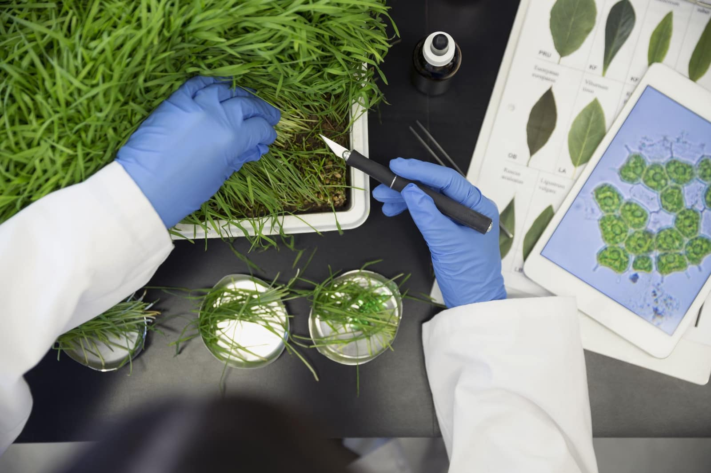
Problem
Statement
01
02
Fragmented Farm Records
Lack of Centralized Management
Where farm information breaks down
Farm and crop information becomes difficult to maintain when records are manual or split across disconnected systems.
Farmers need a single platform to register and manage farms, crops and related agricultural information.
03
04
Difficult Crop & Yield Tracking
Expense Management Gaps
Key data—crop area, soil details, sowing/harvest timeline and yield—require structured, persistent tracking.
Agricultural expenses and crop-inputs need organized digital records for reliable monitoring and planning.
Notes:
2

Slide 4


Proposed Solution
One connected platform for secure, structured farm operations
Secure Authentication
01
Validated registration and login for secure access to the farmer dashboard.
Centralized Farm Management
02
Register and manage multiple farm records in a single platform.
Crop & Yield Tracking
03
Structured tracking of crop area, soil, sowing/harvest timeline and yield.
Expense Management
04
Organize agricultural expenses and crop-input records digitally.
Notes:
3

Slide 5
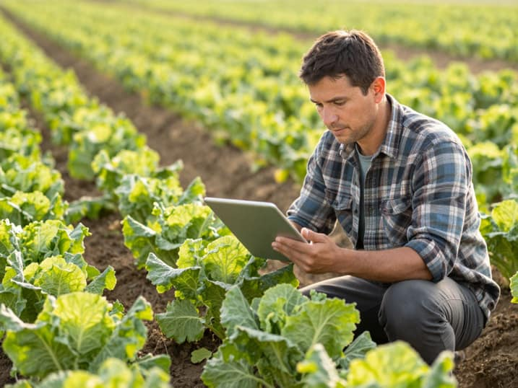
Key Features
A complete operating layer for farmers, crops, expenses and AI-assisted workflows
01
02
03
Farmer Registration & Login
Farmer Dashboard
Farm Management
Secure onboarding and authentication for each farmer.
Centralized access to farm and crop operations.
Register and manage farm information in one place.
04
05
06
Crop Management
Crop & Yield Information
Agricultural Expenses
Add, view and maintain crop records linked to farms.
Track crop area, soil details, sowing/harvest months and yield information.
Record crop inputs and manage agricultural expenses digitally.
07
AI Integration
AI-powered functionality through Hugging Face integrated into the application workflow.
Notes:
4

Slide 6

How Intelligent Farm
Operations Works :-
End-to-end user journey from registration to AI-assisted responses.
01
02
03
04
05
06
07
08
Register
Login
Dashboard
Manage Farms
Manage Crops
Analytics
Expenses
AI
person
lock
dashboard
farm
crop
analytics
receipt
AI
Notes:
5

Slide 7
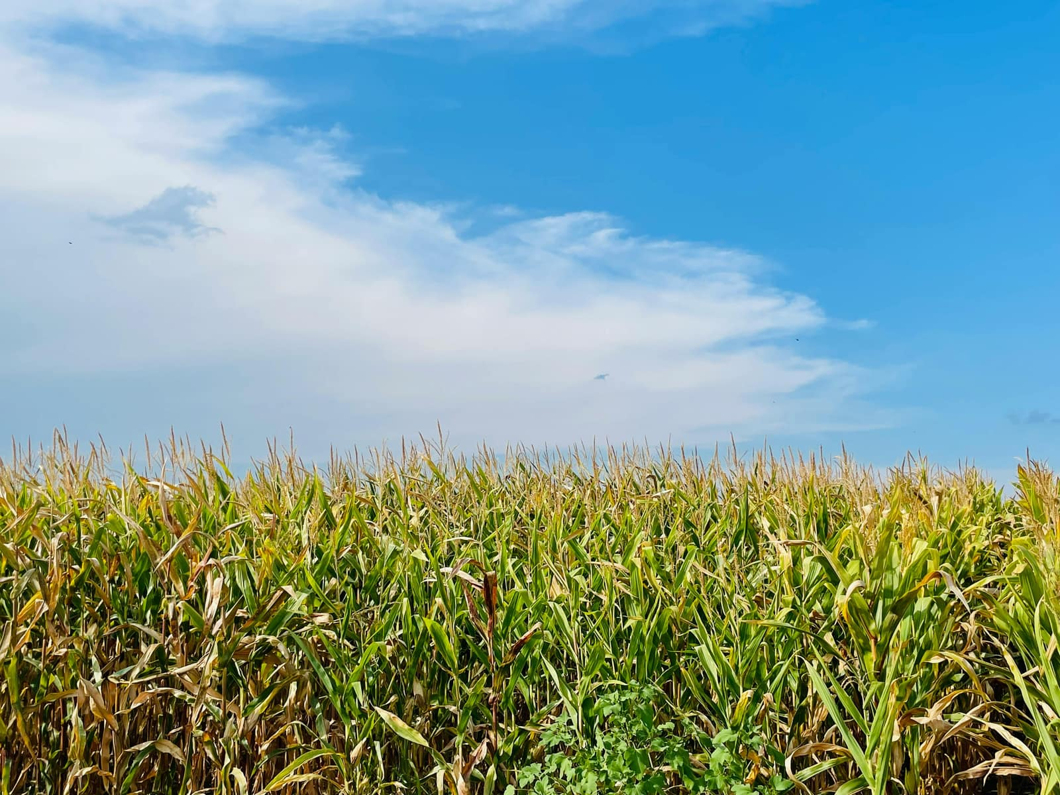
System Architecture
Three-tier Architecture with AI Integration
.
AI Integration
Client
Backend
DataBase
Notes:
6

Slide 8
Technology Stack
Frontend → Backend → Database form the core flow, while AI enhances the platform with intelligent features and insights throughout the system.
Frontend
Backend
React.js requests user interactions to backend.
Java Spring Boot processes requests and connects services.
Database
AI
PostgreSQL stores persistent application data.
Hugging Face API with Llama 3.1 8B Instruct provides intelligent features and AI-powered insights.
Notes:
7

Slide 9
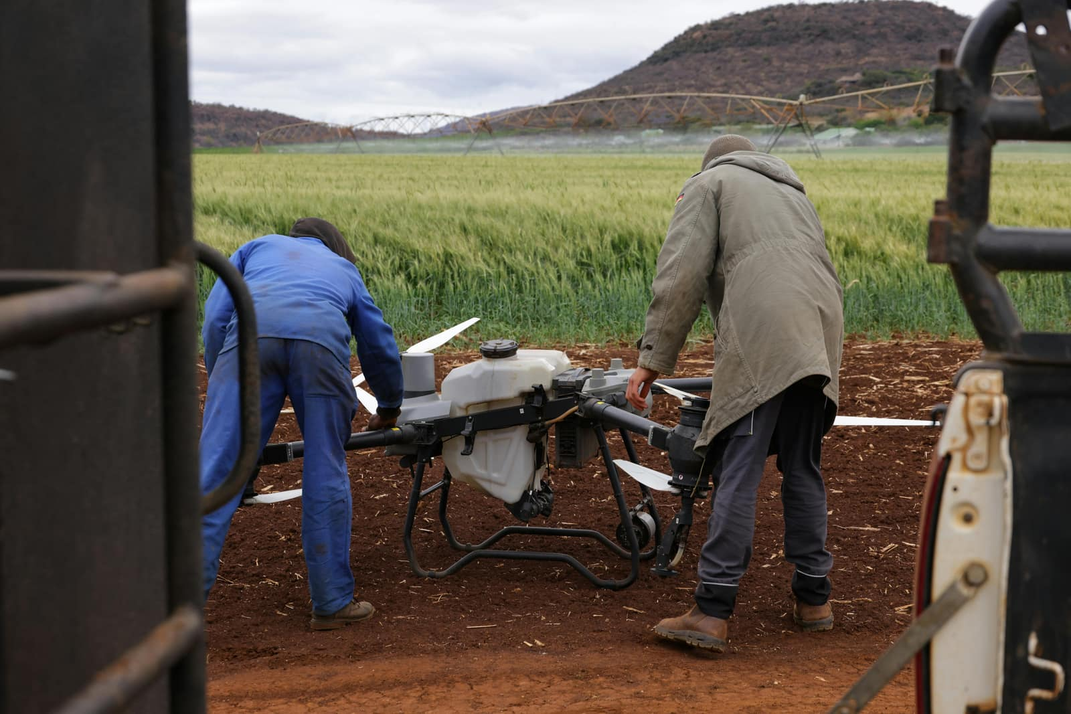



Farm Management
Register farm details
View registered farms
Manage farm information
Crop Management
Add crops to farms
Track crop area
Store soil information
Record sowing month/year
Record harvest month/year
Track yield information
Expense Management
Real-time Tracking
Cost Analysis
Budget Alerts
Expense Reports
OPERATIONS DATA MODEL

Slide 10
Expected Benefits & Impact
MEASURABLE OUTCOMES
01
02
CENTRALIZED FARM MANAGEMENT
BETTER RECORD ORGANIZATION
Bring important farm, crop and agricultural records together within one digital platform.
Provide structured information for farms, crops, soil, timelines and yield.
03
04
IMPROVED EXPENSE VISIBILITY
DIGITAL & AI-ENABLED OPERATIONS
Help organize agricultural expense and crop-input information for easier monitoring and management.
Combine a modern web-based farm management platform with AI capabilities through Hugging Face.
Intelligent Farm Operations Platform is designed to make farm operations more organized, accessible and technology-driven.
Notes:
10

Slide 11
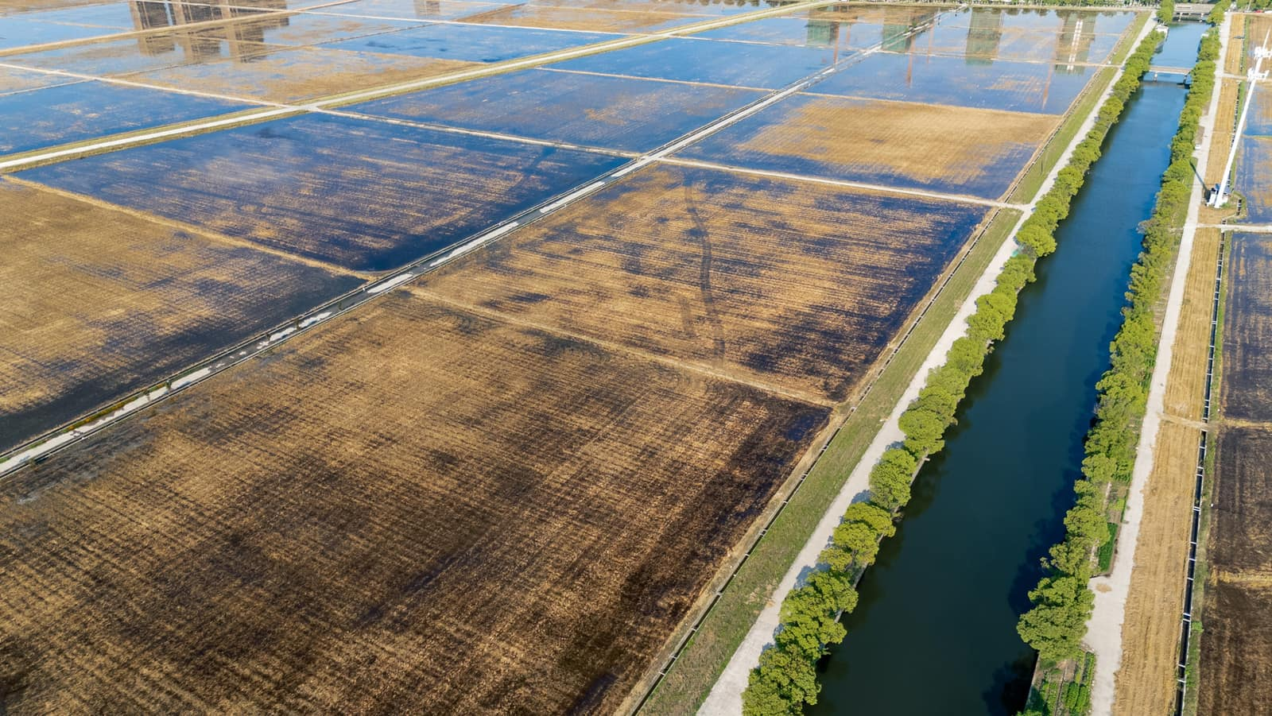
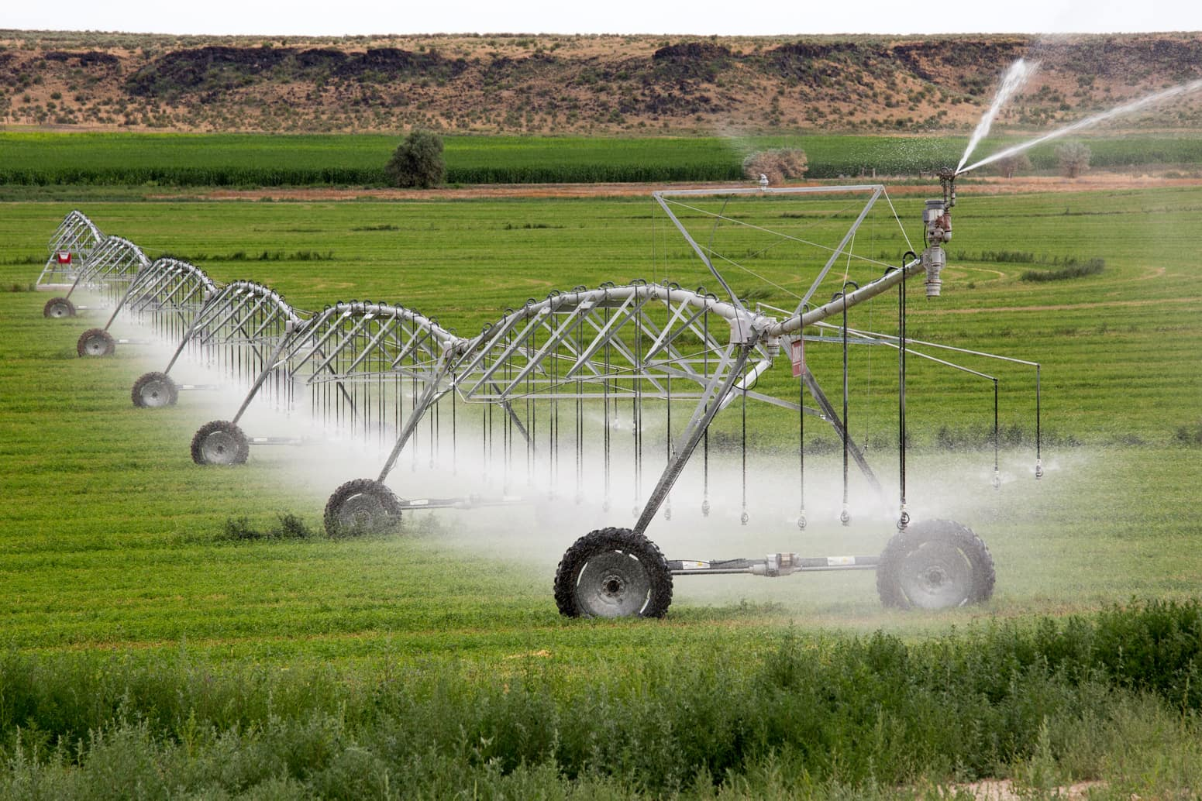
Future Scope & Enhancements
This is committed to continuous innovation, with a strategic roadmap for future development that includes:
01
SMART FARM MONITORING
Potential integration with IoT sensors to collect soil and environmental information.
02
WEATHER & CLIMATE INSIGHTS
Future integration with reliable weather APIs to support weather-aware farm planning.
03
ADVANCED AI ASSISTANCE
Expand AI capabilities to provide more personalized and context-aware agricultural assistance.
04
MOBILE APPLICATION
Develop a dedicated mobile application for convenient access to farm operations from the field.
05
ADVANCED ANALYTICS
Introduce interactive dashboards and analytics for deeper understanding of crop, yield and expense trends.
06
MULTILINGUAL SUPPORT
Isupport multiple regional languages to make the platform more accessible,understandable, and user-friendly for farmers across different regions.
These planned enhancements will further empower farmers with cutting-edge technology for even smarter, more efficient, and data-driven agricultural practices.
Notes:
11

Slide 12
CONCLUSION
Intelligent Farm Operations Platform demonstrates how digital technology can simplify and organize modern agricultural operations. By bringing farm, crop, soil, yield, timeline, and expense management into a centralized platform, it provides a more structured and accessible approach to farm management.
The integration of React.js, Spring Boot, PostgreSQL, and AI capabilities through Hugging Face creates a strong foundation for smarter, technology-driven agricultural operations.
By connecting agriculture with digital technology, FarmVerse provides a foundation for more organized, accessible and intelligent farm operations.
FIELD DATA → INTELLIGENT DECISIONS
Notes:
12

Slide 13



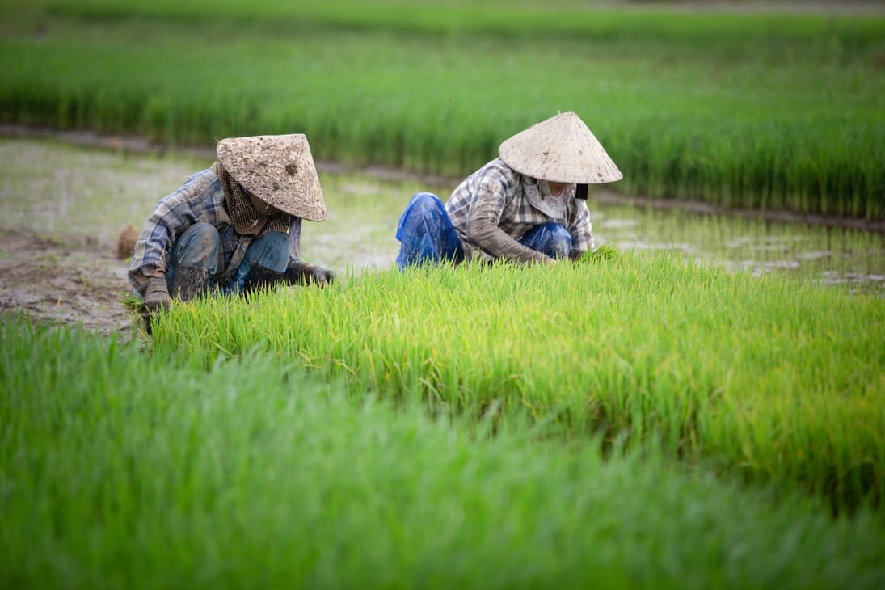

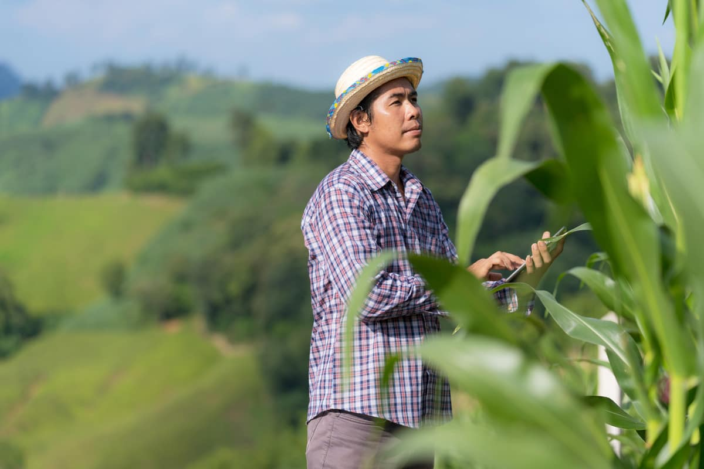



Thank You!
02
01
03

